Slide 1
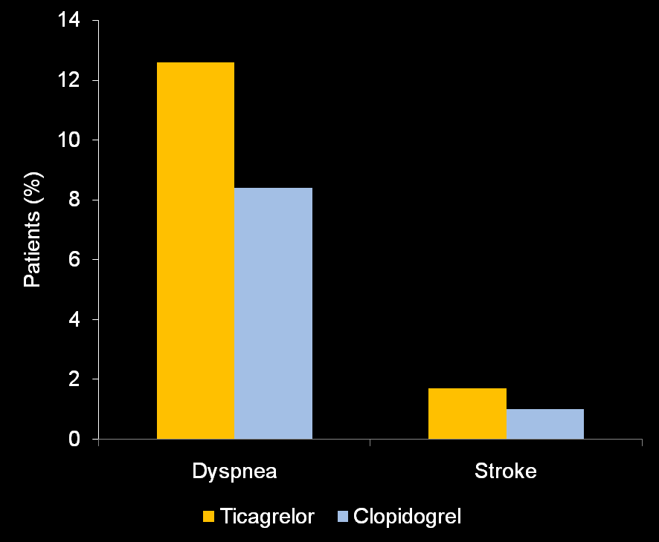
PLATO-STEMI: Ticagrelor increased the risk of stroke and dyspnea
p<0.0001
p=0.02
Steg PG, et al. Circulation 2010;122:2131-41
Notes:
The subgroup analysis of PLATO included 7544 patients with STEMI or new onset left bundle-branch block. Consistently with the overall trial, in patients with STEMI or left bundle-branch block, dyspnea was more common with ticagrelor than clopidogrel (12.6% and 8.4%, respectively; p<0.0001). Ticagrelor also increased the risk of stroke (1.7% and 1.0%, respectively; HR 1.63; 95% CI 1.07 to 2.48; p=0.02).

